Slide 1
Work Package 2
Development and utilization of advanced numerical tools for CCS installations based on MCFC
MOLCAR

Slide 2
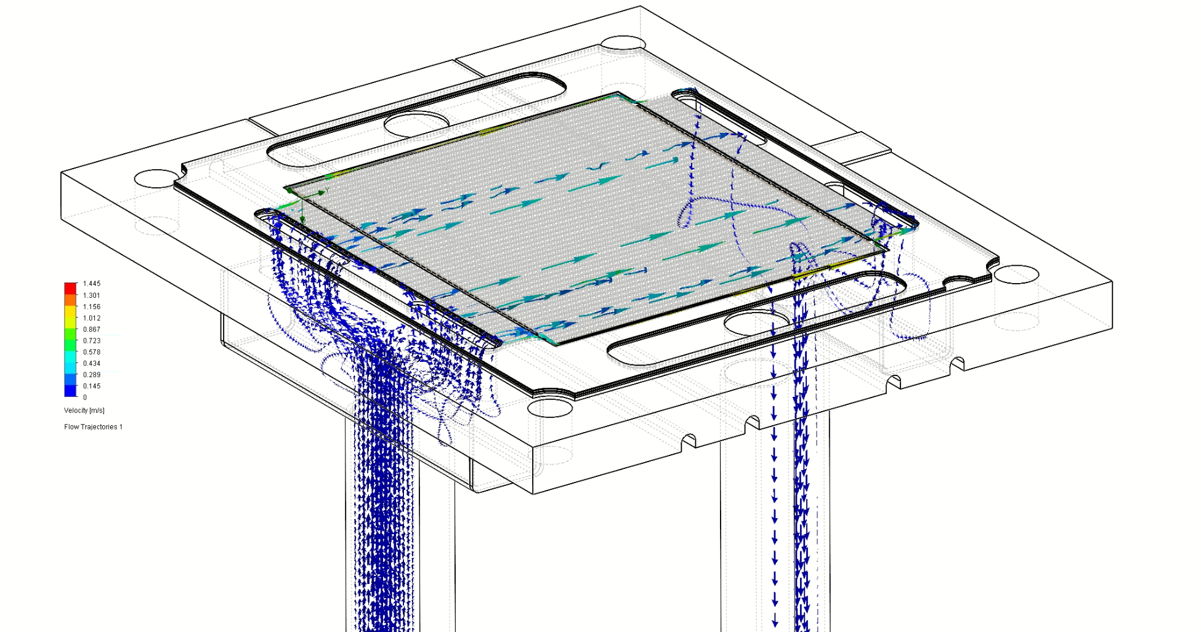
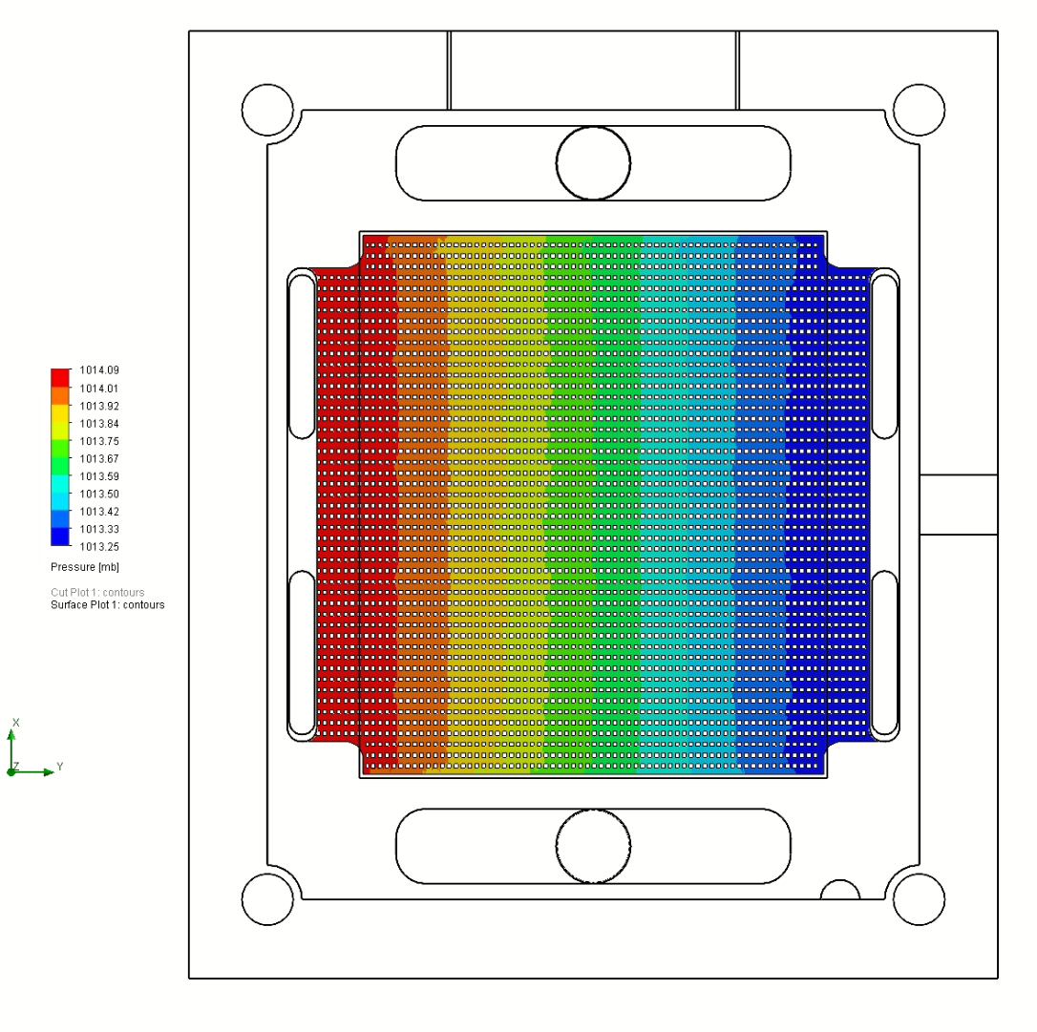
Work Package 2 (11.2020 .. 10.2022)
Goal: Creating an accurate numerical model of the installation with an MCFC stack for conducting variant analyzes
Task 2.1: Parametric model
Task 2.2: Guidelines for the prototype container based installation design
Task 2.3: Computational fluid mechanics (CFD) model
Task 2.4: Tuning and validation of a parametric model of the installation from the MCFC
Task 2.5: Verification of assumptions and optimization of operating parameters

Slide 3
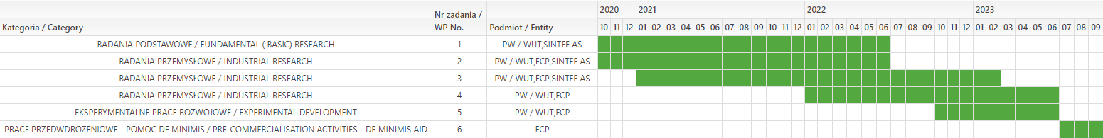

Slide 4
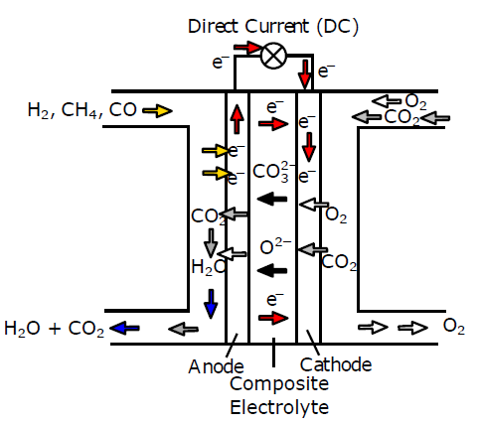
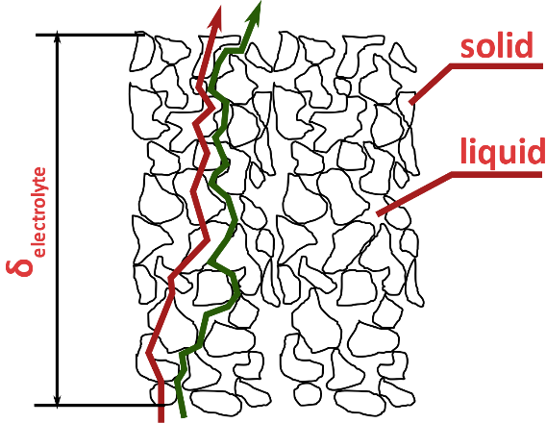
Task 2.1: Parametric model
Working principles of a dual conductivity Molten Carbonate Fuel Cell

Slide 5
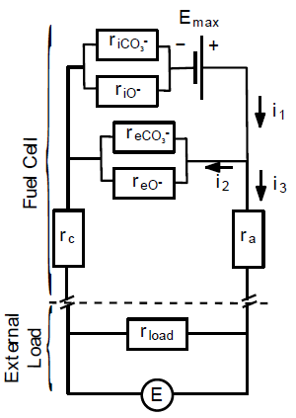
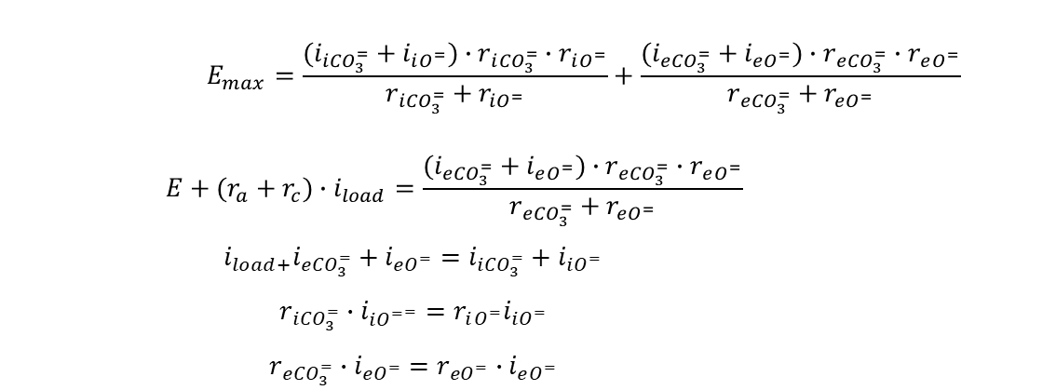

Task 2.1: Parametric model
$$E_{max}=\frac{(i_{i{CO}_{3}^{=}}+i_{iO^{=}})∙r_{i{CO}_{3}^{=}}∙r_{iO^{=}}}{r_{i{CO}_{3}^{=}}+r_{iO^{=}}}+\frac{(i_{e{CO}_{3}^{=}}+i_{eO^{=}})∙r_{e{CO}_{3}^{=}}∙r_{eO^{=}}}{r_{e{CO}_{3}^{=}}+r_{eO^{=}}}$$ $$E+(r_{a}+r_{c})∙i_{load}=\frac{(i_{e{CO}_{3}^{=}}+i_{eO^{=}})∙r_{e{CO}_{3}^{=}}∙r_{eO^{=}}}{r_{e{CO}_{3}^{=}}+r_{eO^{=}}}$$ $$i_{load+}i_{e{CO}_{3}^{=}}+i_{eO^{=}}=i_{i{CO}_{3}^{=}}+i_{iO^{=}}$$ $$r_{i{CO}_{3}^{=}}∙i_{i{O^{=}}^{=}}=r_{iO^{=}}i_{iO^{=}}$$ $$r_{e{CO}_{3}^{=}}∙i_{eO^{=}}=r_{{eO}^{=}}∙i_{eO^{=}}$$
$$E=\frac{E_{max}−i_{load}\frac{r_{iO^{=}}∙r_{i{CO}_{3}^{=}}}{r_{iO^{=}}+r_{i{CO}_{3}^{=}}}(r_{a}+r_{c})(1+\frac{1}{r_{i{CO}_{3}^{=}}}+\frac{1}{r_{iO^{=}}}+\frac{1}{r_{eO^{=}}}+\frac{1}{r_{e{CO}_{3}^{=}}})}{1+\frac{r_{iO^{=}}}{r_{iO^{=}}+r_{i{CO}_{3}^{=}}}\frac{r_{i{CO}_{3}^{=}}}{r_{e{CO}_{3}^{=}}}+\frac{r_{i{CO}_{3}^{=}}}{r_{iO^{=}}+r_{i{CO}_{3}^{=}}}\frac{r_{iO^{=}}}{r_{eO^{=}}}}$$

Slide 6

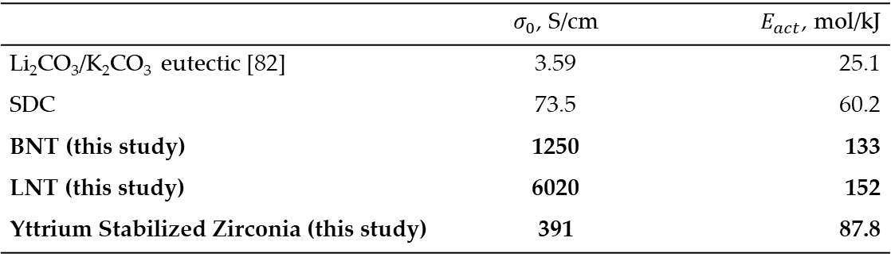

Task 2.1: Parametric model
$$r=\frac{δ}{σ_{{CO}_{3}^{=}}∙ρ+σ_{O^{=}}∙\left(1−δ\right)}$$
$$σ=σ_{0}ⅇ^{\frac{−E_{act}}{R⋅T}}$$
 | $σ_{0}$, S/cm | $E_{act}$, mol/kJ
Li₂CO₃/K₂CO₃ eutectic [82] | 3.59 | 25.1
SDC | 73.5 | 60.2
BNT (this study) | 1250 | 133
LNT (this study) | 6020 | 152
Yttrium Stabilized Zirconia (this study) | 391 | 87.8

Slide 7
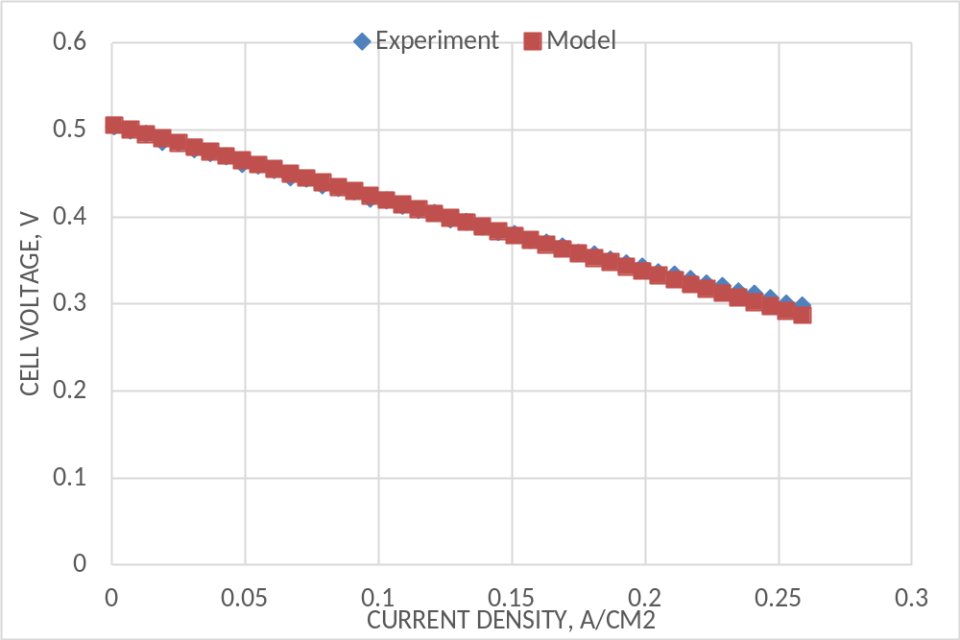
Task 2.1: Parametric model – Li₂CO₃/K₂CO₃-BNT model
Model validation results for double conductivity electrolyte liK-BNT (Cell 1), tortuosity of BNT 25, tortuosity of LiK 6.6; r_eCO3 of LiK 1.64 Ohm x cm2, r_eO of BNT 179 Ohm x cm2

Slide 8
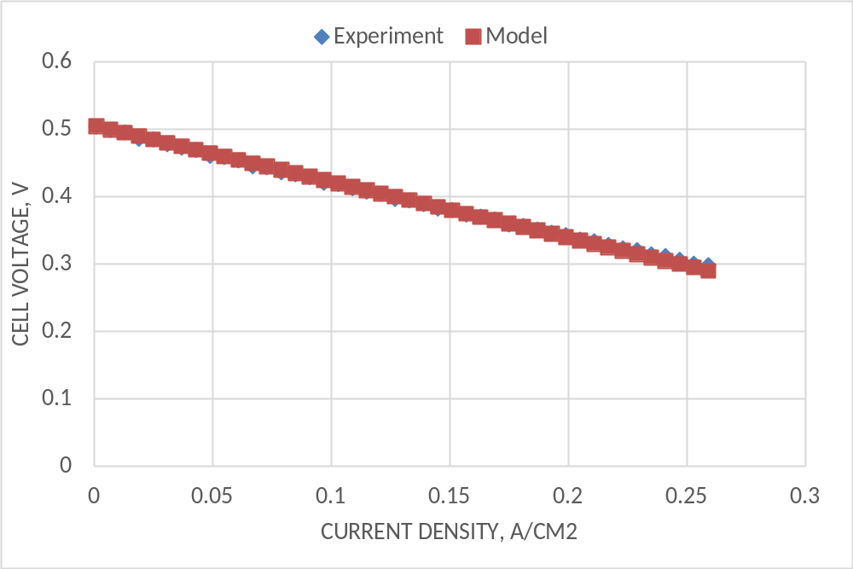
Task 2.1: Parametric model – Li₂CO₃/K₂CO₃-BNT model
Model validation results for double conductivity electrolyte LiK-BNT (Cell 2), tortuosity of BNT 0.0009 tortuosity of LiK 61; r_eCO3 of LiK 1.59 Ohm x cm2, r_eO of BNT 35 Ohm x cm2

Slide 9
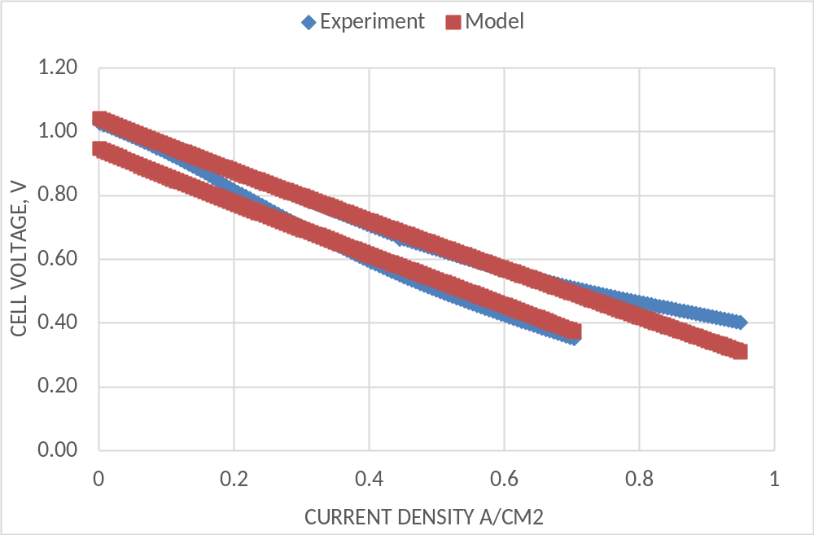
Task 2.1: Parametric model – Li₂CO₃/K₂CO₃-LNT model
Model validation results for double conductivity electrolyte liK-LNT, tortuosity of LNT 0.00064, tortuosity of LiK 7.9; r_eCO3 of LiK 6.2 Ohm x cm², r_eO of LNT 1540 Ohm x cm²

Slide 10
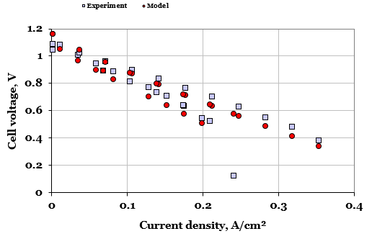
Task 2.1: Parametric model – Li₂CO₃/K₂CO₃-YSZ model

Slide 11
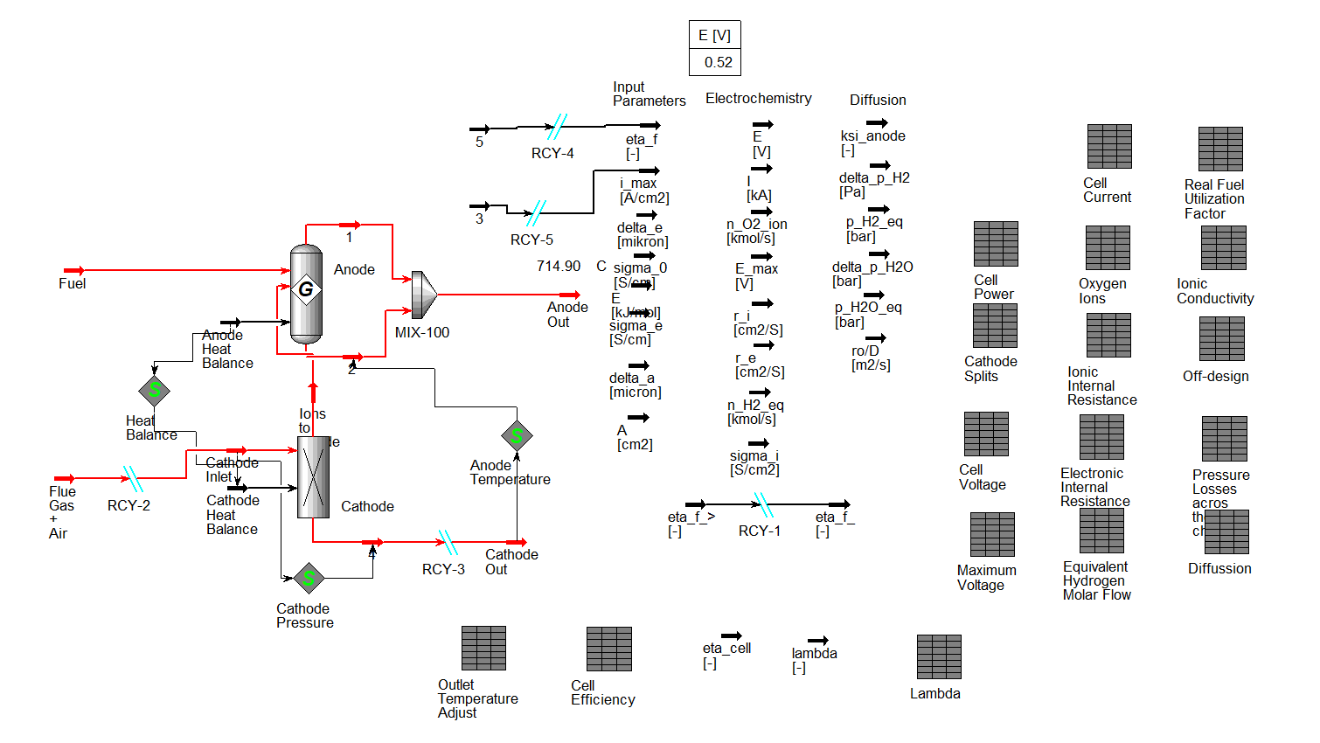
Task 2.1: Parametric model implementation into Aspen HYSYS

Slide 12
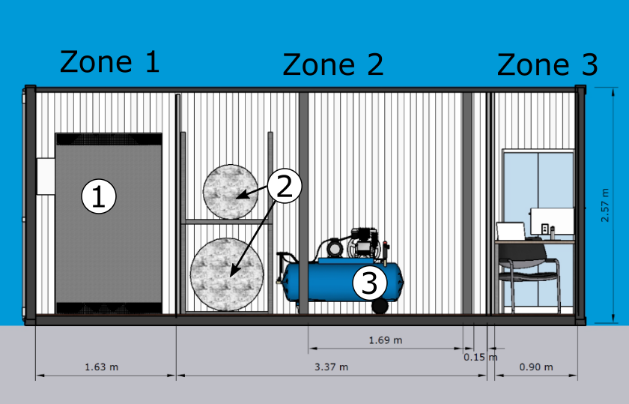
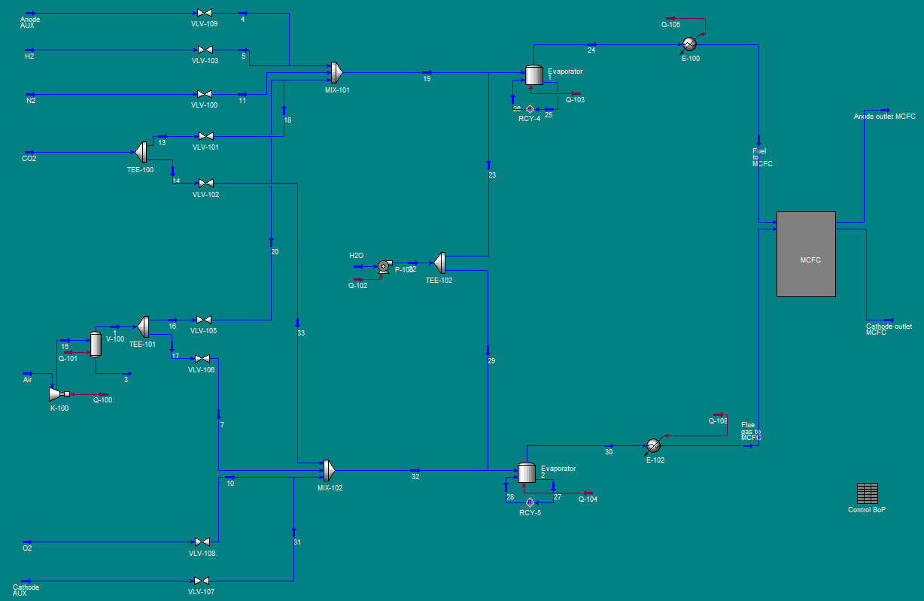
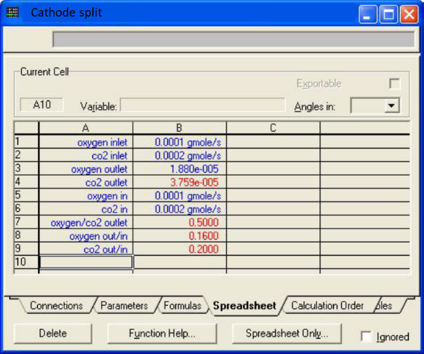
Task 2.2: Guidelines for the prototype container based installation design

Slide 13
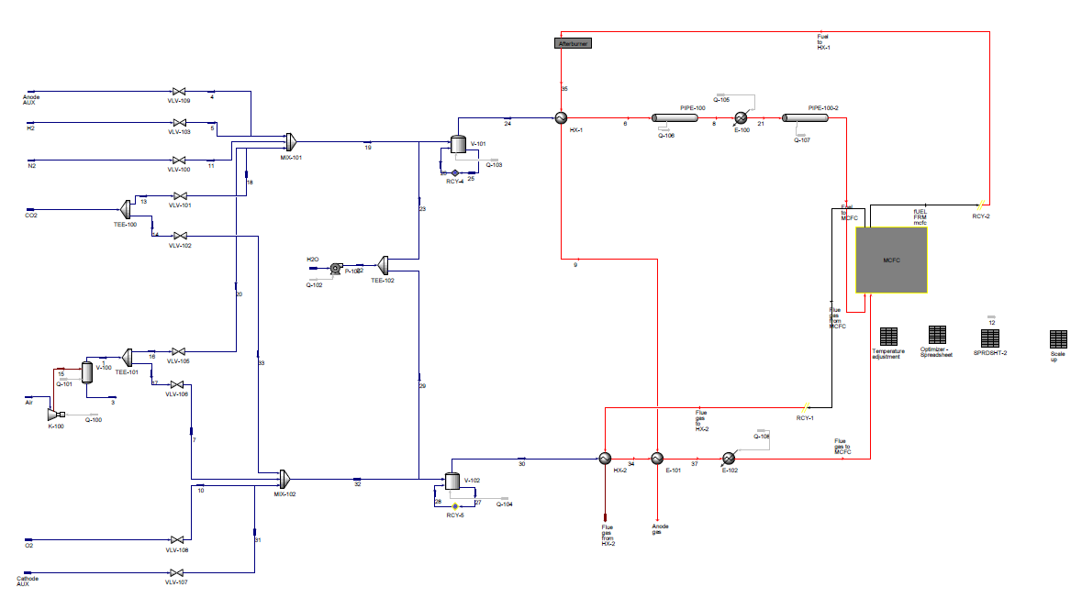
Task 2.2: Guidelines for the prototype container based installation design
Thermal management zone
10 kW MCFC stack
Inlet gases control zone
Gases humidifying zone

Slide 14
Task 2.2: Guidelines for the prototype container based installation design
A proposed configuration of flows regulating system, proposed by results of the parametric BoP model.
N | Working medium | Flow rate, NL/min |  | I/O signal | P-in | P-out
 |  | min | max
1 | Air | 5 | 1800 | 4..21 mA | 2.5 | 0.5
2 | Air | 1 | 300 | 4..21 mA | 2.5 | 0.5
3 | Air | 0 | 33 | 4..21 mA | 2.5 | 0.5
4 | CO2 | 7.5 | 300 | 4..21 mA | 2.5 | 0.5
5 | CO2 | 0.1 | 15 | 4..21 mA | 2.5 | 0.5
6 | CO2 | 0 | 35 | 4..21 mA | 2.5 | 0.5
7 | N2 | 5 | 300 | 4..21 mA | 2.5 | 0.5
8 | N2 | 12 | 500 | 4..21 mA | 2.5 | 0.5
9 | H2 | 0 | 5 | 4..21 mA | 2.5 | 0.5
10 | H2 | 6 | 250 | 4..21 mA | 2.5 | 0.5

Slide 15
Task 2.2: Guidelines for the prototype container based installation design
A proposed configuration of heating system, proposed by results of the parametric BoP model
N | Working medium | Power rate, kW |  | T_max, C deg
 |  | min | max
1 | Cathodic main electric heater | 10 | 15 | 800
2 | Cathodic supporting electric heater | 1.2 | 3 | 900
3 | Anodic main electric heater | 2 | 5 | 800
4 | Anodic supporting electric heater | 1.2 | 3 | 900
5 | Water steam generator | 1.3 | 3 | 400

Slide 16
Task 2.2: Guidelines for the prototype container based installation design
A proposed configuration of electronic load system, proposed by results of the parametric BoP model
N | Device type | Operating voltage, V |  | Operating current, A |  | Sircuit
 |  | min | max | min | max
1 | Electronic load | 5 | 300 | 0 | 150 | DC

Slide 17
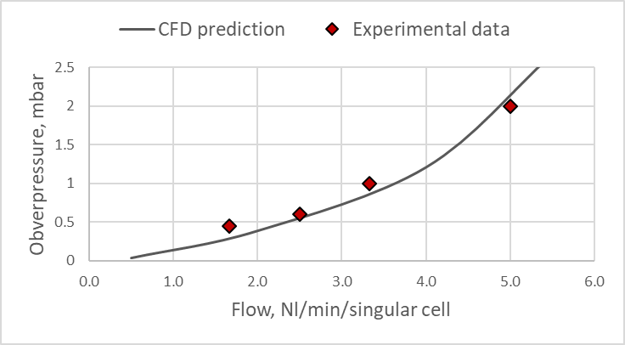
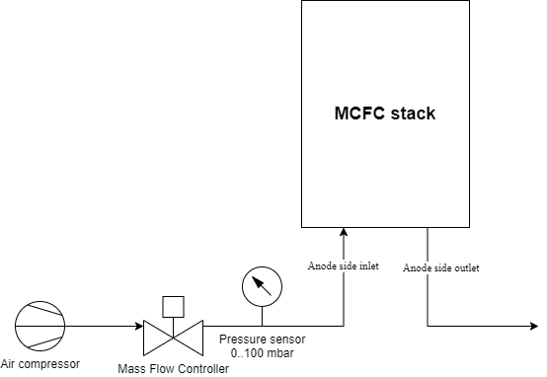
Task 2.3: Computational fluid mechanics (CFD) model

Slide 18

Task 2.3: Computational fluid mechanics (CFD) model
Internal flow distribution study and optimization
Anodic and cathodic channels geometry estimation

Slide 19
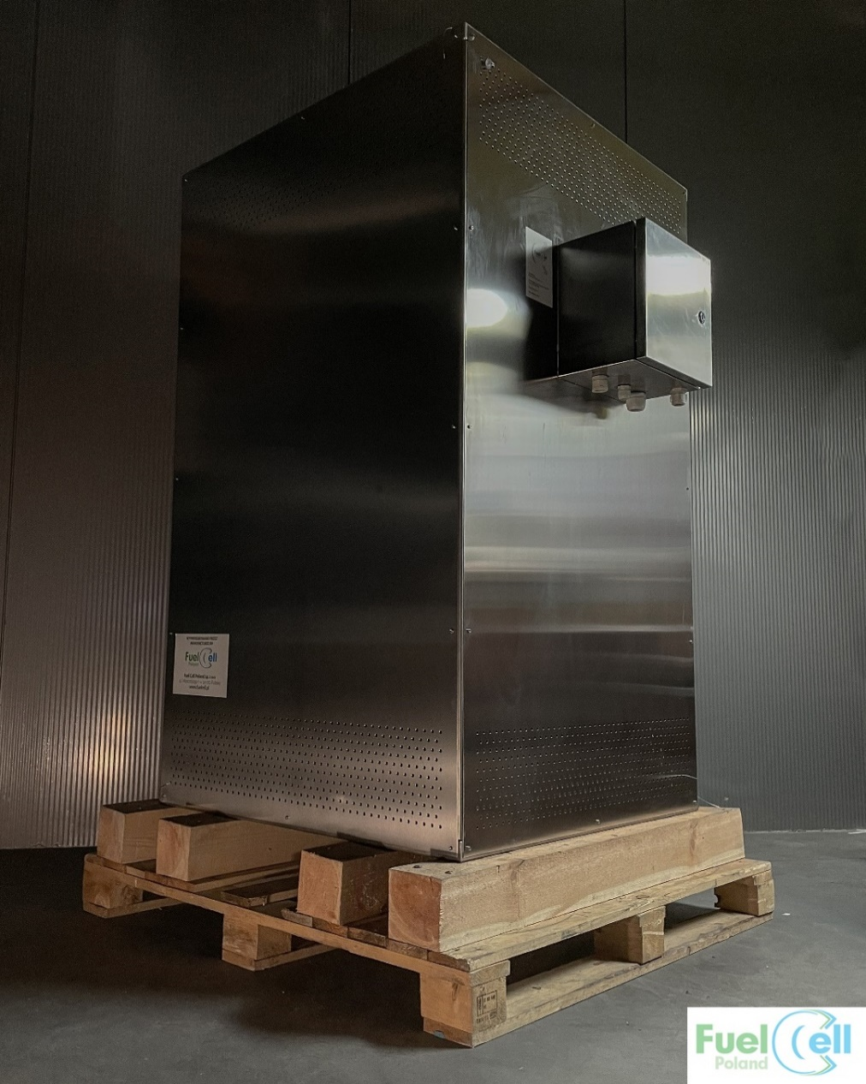
Task 2.3: Computational fluid mechanics (CFD) model
Experimental set-up used to test pressure drop in MCFC stack
A 5kW MCFC stack, used as a reference for CFD model and validation

Slide 20
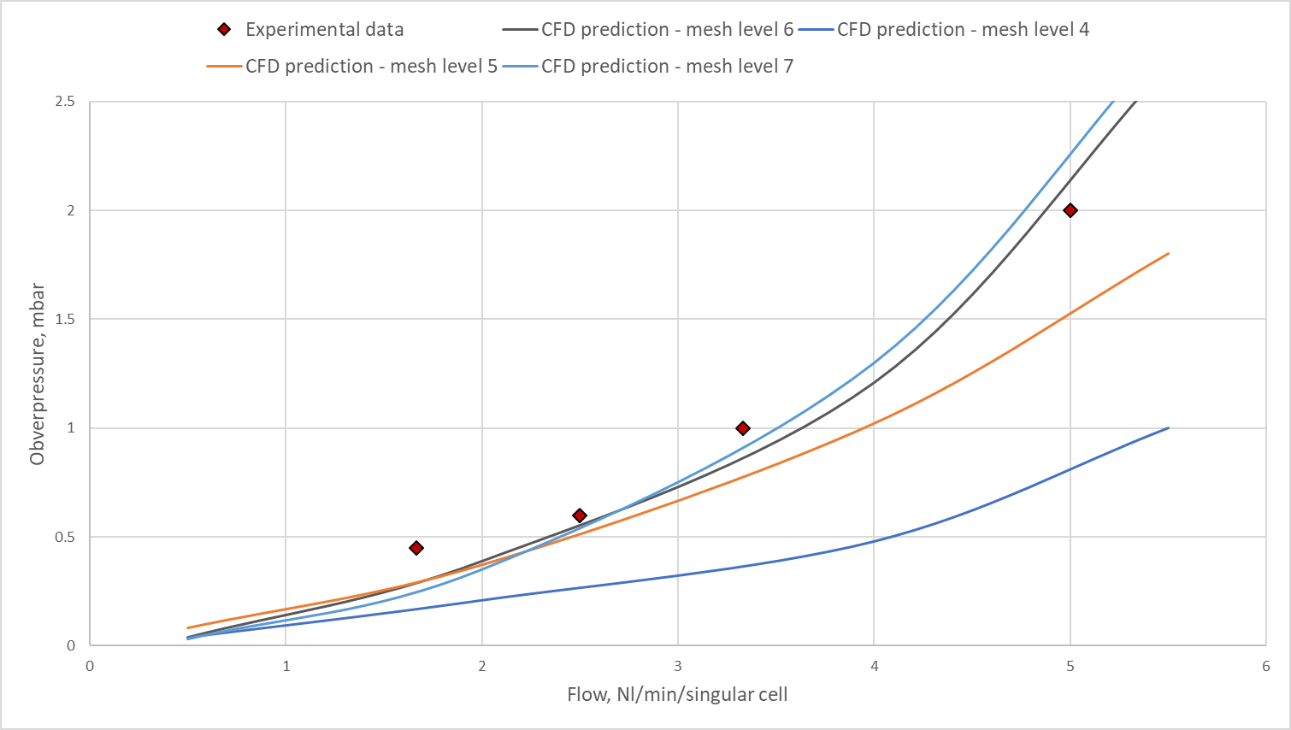
Task 2.3: Computational fluid mechanics (CFD) model

Slide 21
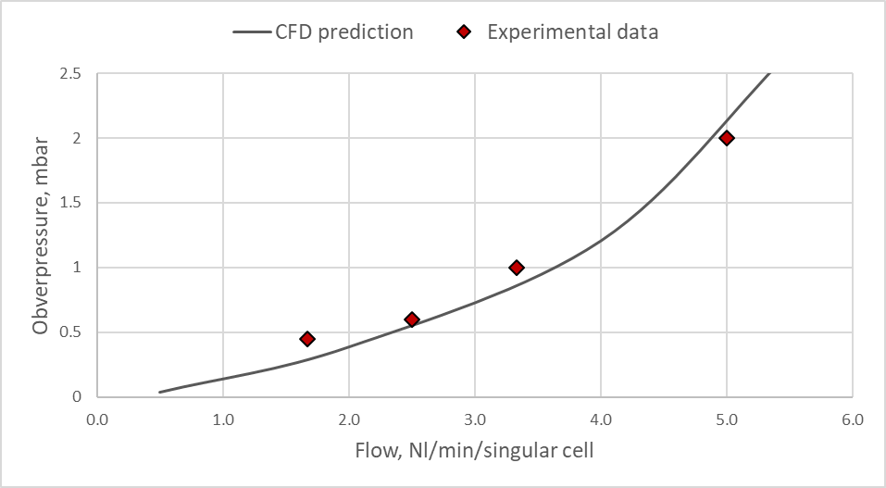
Task 2.3: Computational fluid mechanics (CFD) model

Slide 22
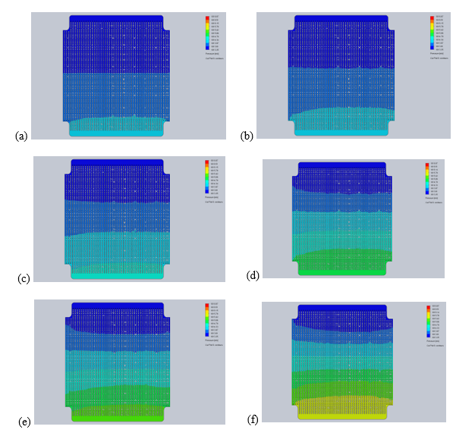
Task 2.3: Computational fluid mechanics (CFD) model
0.5 Nl/min: a) 450°C, b) 500°C, c) 650°C
2.0 Nl/min: d) 450°C, e) 500°C, f) 650°C

Slide 23
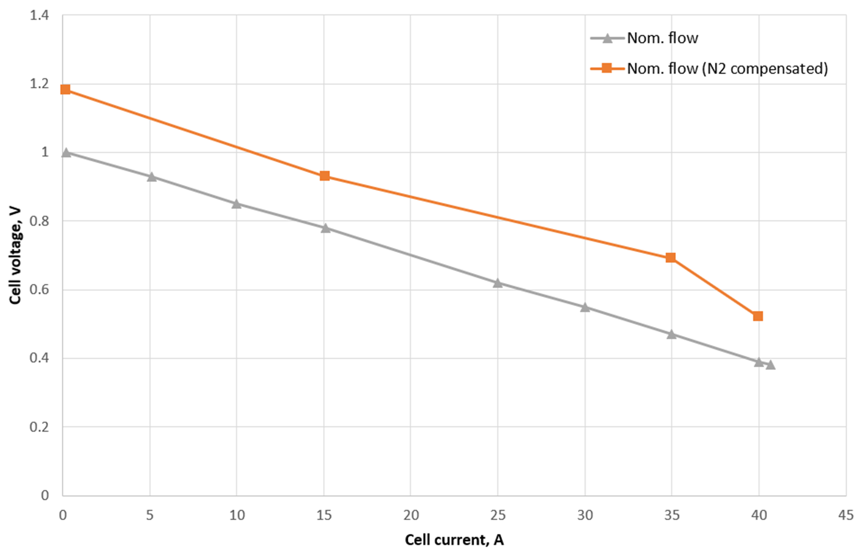
Task 2.4: Tuning and validation of a parametric model of the installation from the MCFC

Slide 24
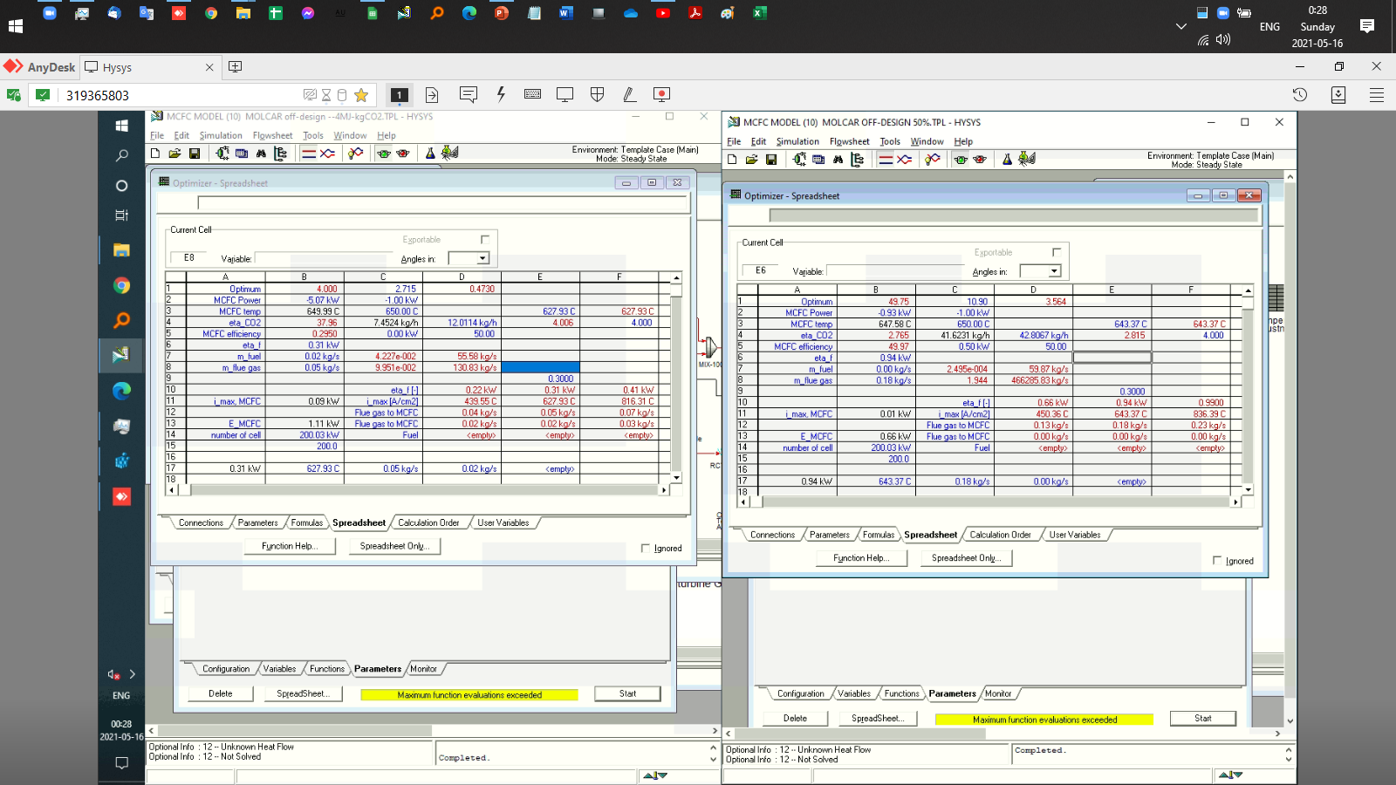
Task 2.5: Verification of assumptions and optimization of operating parameters

